Slide 1
Classification: Logistic Regression
Hung-yi Lee
李宏毅
Notes:
Good ref:
http://www.win-vector.com/blog/2011/09/the-simpler-derivation-of-logistic-regression/
http://www.cs.columbia.edu/~smaskey/CS6998/slides/statnlp_week6.pdf
http://www.win-vector.com/dfiles/LogisticRegressionMaxEnt.pdf
New ton:
http://qwone.com/~jason/writing/lr.pdf
Gradient descent/Another point of view
Why not MSE
Multiple Limit
Ds v.s. generative X 2

Slide 2
有關分組
作業以個人為單位繳交
期末專題才需要分組
找不到組員也沒有關係，期末專題公告後找不到組員的同學助教會幫忙湊對

Slide 3
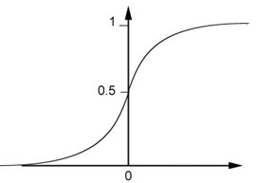

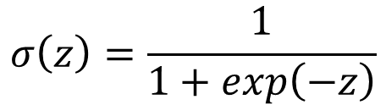

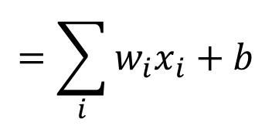


Step 1: Function Set
Function set:
Including all different w and b
$$P_{w,b}\left(C_{1}|x\right)≥0.5$$
class 1
z
0
$$P_{w,b}\left(C_{1}|x\right)<0.5$$
class 2
z
0
$$P_{w,b}\left(C_{1}|x\right)=σ\left(z\right)$$
$$=\sum_{i}{w_{i}x_{i}}+b$$
$$z=w∙x+b$$
$$σ\left(z\right)=\frac{1}{1+exp\left(−z\right)}$$

Slide 4

Step 1: Function Set
…
…
$$P_{w,b}\left(C_{1}|x\right)$$
…
…
Sigmoid Function
Notes:
Activation function

Slide 5










Step 2: Goodness of a Function
Training
Data
$$x^{1}$$
$$x^{2}$$
$$x^{3}$$
$$x^{N}$$
$$……$$
$$C_{1}$$
$$C_{1}$$
$$C_{2}$$
$$C_{1}$$
Assume the data is generated based on $f_{w,b}\left(x\right)=P_{w,b}\left(C_{1}|x\right)$
Given a set of w and b, what is its probability of generating the data?
$$L\left(w,b\right)=f_{w,b}\left(x^{1}\right)f_{w,b}\left(x^{2}\right)\left(1−f_{w,b}\left(x^{3}\right)\right)⋯f_{w,b}\left(x^{N}\right)$$
The most likely w* and b* is the one with the largest $L\left(w,b\right)$.
$$w^{∗},b^{∗}=arg\max_{w,b}{L\left(w,b\right)}$$
Notes:
All the w and b give non-zero probability

Slide 6
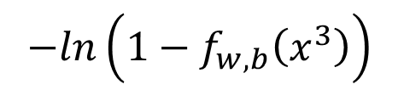







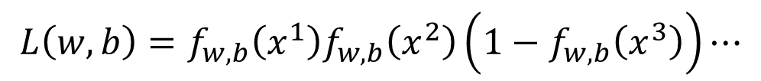








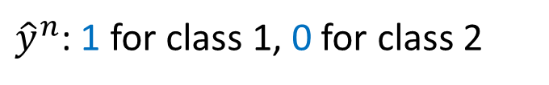


$$x^{1}$$
$$x^{2}$$
$$x^{3}$$
$$x^{1}$$
$$x^{2}$$
$$x^{3}$$
$$……$$
$$……$$
$$C_{1}$$
$$C_{1}$$
$$C_{2}$$
$${\hat{y}}^{1}=1$$
$${\hat{y}}^{2}=1$$
$${\hat{y}}^{3}=0$$
${\hat{y}}^{n}$: 1 for class 1, 0 for class 2
$$L\left(w,b\right)=f_{w,b}\left(x^{1}\right)f_{w,b}\left(x^{2}\right)\left(1−f_{w,b}\left(x^{3}\right)\right)⋯$$
$$w^{∗},b^{∗}=arg\max_{w,b}{L\left(w,b\right)}$$
=
$$w^{∗},b^{∗}=arg\min_{w,b}{−lnL\left(w,b\right)}$$
$$−lnL\left(w,b\right)$$
$$=−lnf_{w,b}\left(x^{1}\right)$$
1
$$−\left[{\hat{y}}^{1}lnf\left(x^{1}\right)+\left(1−{\hat{y}}^{1}\right)ln\left(1−f\left(x^{1}\right)\right)\right]$$
0
$$−lnf_{w,b}\left(x^{2}\right)$$
1
$$−\left[{\hat{y}}^{2}lnf\left(x^{2}\right)+\left(1−{\hat{y}}^{2}\right)ln\left(1−f\left(x^{2}\right)\right)\right]$$
0
$$−ln\left(1−f_{w,b}\left(x^{3}\right)\right)$$
$$−\left[{\hat{y}}^{3}lnf\left(x^{3}\right)+\left(1−{\hat{y}}^{3}\right)ln\left(1−f\left(x^{3}\right)\right)\right]$$
0
1
……

Slide 7


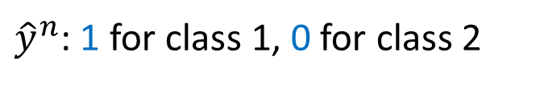
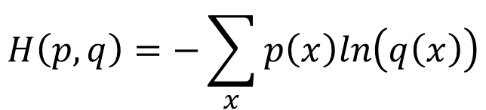
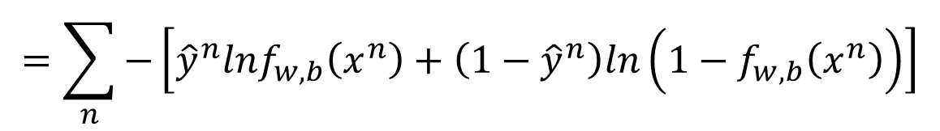


Step 2: Goodness of a Function
$$L\left(w,b\right)=f_{w,b}\left(x^{1}\right)f_{w,b}\left(x^{2}\right)\left(1−f_{w,b}\left(x^{3}\right)\right)⋯f_{w,b}\left(x^{N}\right)$$
$$−lnL\left(w,b\right)=lnf_{w,b}\left(x^{1}\right)+lnf_{w,b}\left(x^{2}\right)+ln\left(1−f_{w,b}\left(x^{3}\right)\right)⋯$$
${\hat{y}}^{n}$: 1 for class 1, 0 for class 2
$$=\sum_{n}{−\left[{\hat{y}}^{n}lnf_{w,b}\left(x^{n}\right)+\left(1−{\hat{y}}^{n}\right)ln\left(1−f_{w,b}\left(x^{n}\right)\right)\right]}$$
Cross entropy between two Bernoulli distribution
Distribution p:
Distribution q:
$$p\left(x=1\right)={\hat{y}}^{n}$$
cross entropy
$$q\left(x=1\right)=f\left(x^{n}\right)$$
$$p\left(x=0\right)={1−\hat{y}}^{n}$$
$$q\left(x=0\right)=1−f\left(x^{n}\right)$$
$$H\left(p,q\right)=−\sum_{x}{p\left(x\right)ln\left(q\left(x\right)\right)}$$
Notes:
Where does it comes from?

Slide 8



Step 2: Goodness of a Function
$$L\left(w,b\right)=f_{w,b}\left(x^{1}\right)f_{w,b}\left(x^{2}\right)\left(1−f_{w,b}\left(x^{3}\right)\right)⋯f_{w,b}\left(x^{N}\right)$$
$$−lnL\left(w,b\right)=lnf_{w,b}\left(x^{1}\right)+lnf_{w,b}\left(x^{2}\right)+ln\left(1−f_{w,b}\left(x^{3}\right)\right)⋯$$
${\hat{y}}^{n}$: 1 for class 1, 0 for class 2
$$=\sum_{n}{−\left[{\hat{y}}^{n}lnf_{w,b}\left(x^{n}\right)+\left(1−{\hat{y}}^{n}\right)ln\left(1−f_{w,b}\left(x^{n}\right)\right)\right]}$$
Cross entropy between two Bernoulli distribution
minimize
1.0
$$f\left(x^{n}\right)$$
0.0
cross entropy
$$1−f\left(x^{n}\right)$$
Ground Truth
$${\hat{y}}^{n}=1$$
Notes:
Where does it comes from?

Slide 9
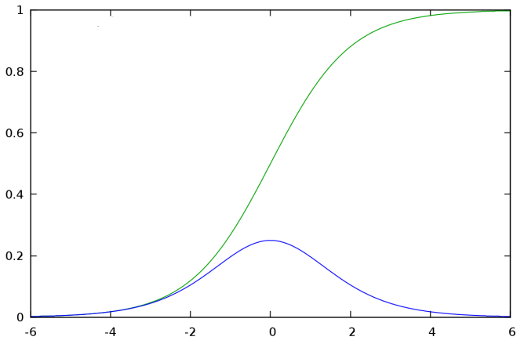

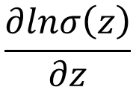


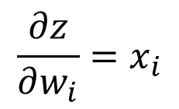




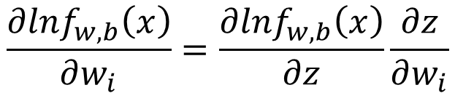

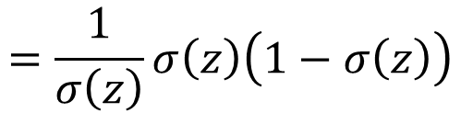
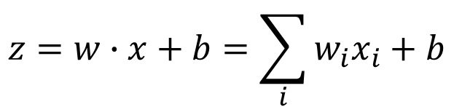

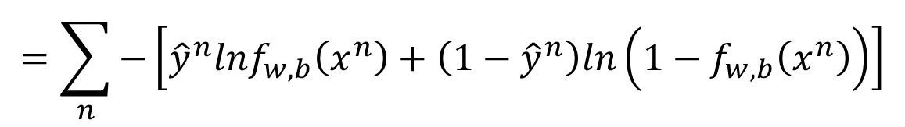
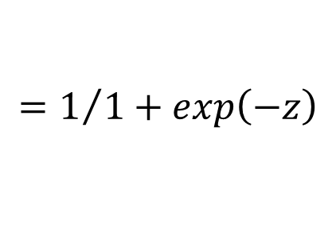
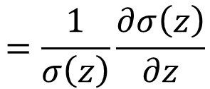
Step 3: Find the best function
$$\left(1−f_{w,b}\left(x^{n}\right)\right)x_{i}^{n}$$
$$=\sum_{n}{−\left[{\hat{y}}^{n}lnf_{w,b}\left(x^{n}\right)+\left(1−{\hat{y}}^{n}\right)ln\left(1−f_{w,b}\left(x^{n}\right)\right)\right]}$$
$$−lnL\left(w,b\right)$$
$$∂w_{i}$$
$$∂w_{i}$$
$$∂w_{i}$$
$$\frac{∂lnf_{w,b}\left(x\right)}{∂w_{i}}=\frac{∂lnf_{w,b}\left(x\right)}{∂z}\frac{∂z}{∂w_{i}}$$
$$\frac{∂z}{∂w_{i}}=x_{i}$$
$$σ\left(z\right)$$
$$\frac{∂σ\left(z\right)}{∂z}$$
$$\frac{∂lnσ\left(z\right)}{∂z}$$
$$=\frac{1}{σ\left(z\right)}\frac{∂σ\left(z\right)}{∂z}$$
$$=\frac{1}{σ\left(z\right)}σ\left(z\right)\left(1−σ\left(z\right)\right)$$
$$f_{w,b}\left(x\right)$$
$$=σ\left(z\right)$$
$$z=w∙x+b=\sum_{i}{w_{i}x_{i}}+b$$
$$=1/{1+exp\left(−z\right)}$$

Slide 10

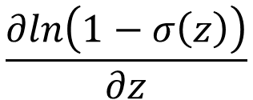

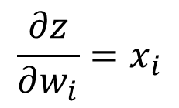

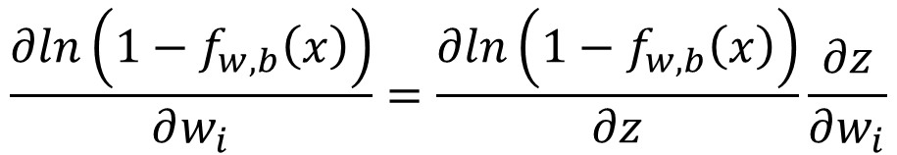
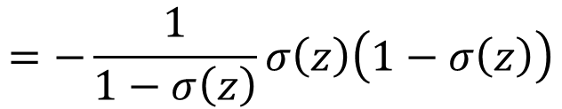
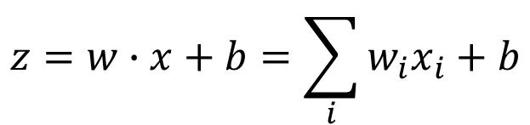
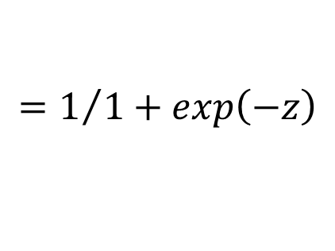
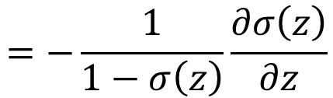
Step 3: Find the best function
$$\left(1−f_{w,b}\left(x^{n}\right)\right)x_{i}^{n}$$
$$−f_{w,b}\left(x^{n}\right)x_{i}^{n}$$
$$=\sum_{n}{−\left[{\hat{y}}^{n}lnf_{w,b}\left(x^{n}\right)+\left(1−{\hat{y}}^{n}\right)ln\left(1−f_{w,b}\left(x^{n}\right)\right)\right]}$$
$$−lnL\left(w,b\right)$$
$$∂w_{i}$$
$$∂w_{i}$$
$$∂w_{i}$$
$$\frac{∂ln\left(1−f_{w,b}\left(x\right)\right)}{∂w_{i}}=\frac{∂ln\left(1−f_{w,b}\left(x\right)\right)}{∂z}\frac{∂z}{∂w_{i}}$$
$$\frac{∂z}{∂w_{i}}=x_{i}$$
$$\frac{∂ln\left(1−σ\left(z\right)\right)}{∂z}$$
$$=−\frac{1}{1−σ\left(z\right)}\frac{∂σ\left(z\right)}{∂z}$$
$$=−\frac{1}{1−σ\left(z\right)}σ\left(z\right)\left(1−σ\left(z\right)\right)$$
$$f_{w,b}\left(x\right)$$
$$=σ\left(z\right)$$
$$z=w∙x+b=\sum_{i}{w_{i}x_{i}}+b$$
$$=1/{1+exp\left(−z\right)}$$

Slide 11
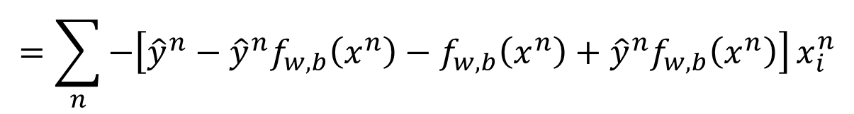
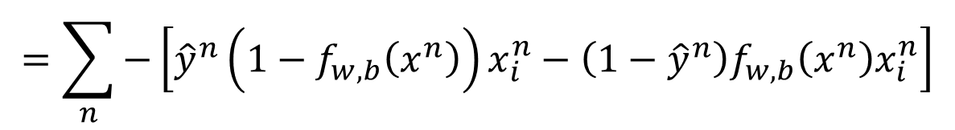

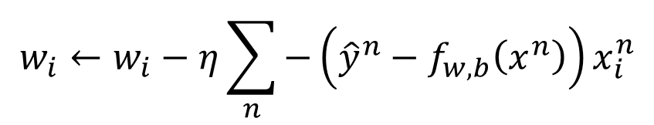
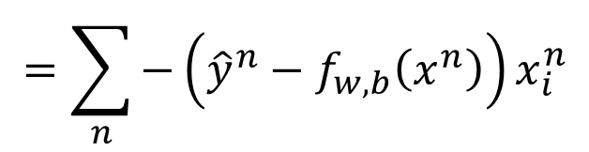
Step 3: Find the best function
$$\left(1−f_{w,b}\left(x^{n}\right)\right)x_{i}^{n}$$
$$−f_{w,b}\left(x^{n}\right)x_{i}^{n}$$
$$=\sum_{n}{−\left[{\hat{y}}^{n}lnf_{w,b}\left(x^{n}\right)+\left(1−{\hat{y}}^{n}\right)ln\left(1−f_{w,b}\left(x^{n}\right)\right)\right]}$$
$$−lnL\left(w,b\right)$$
$$∂w_{i}$$
$$∂w_{i}$$
$$∂w_{i}$$
$$=\sum_{n}{−\left[{\hat{y}}^{n}\left(1−f_{w,b}\left(x^{n}\right)\right)x_{i}^{n}−\left(1−{\hat{y}}^{n}\right)f_{w,b}\left(x^{n}\right)x_{i}^{n}\right]}$$
$$=\sum_{n}{−\left[{\hat{y}}^{n}−{\hat{y}}^{n}f_{w,b}\left(x^{n}\right)−f_{w,b}\left(x^{n}\right)+{\hat{y}}^{n}f_{w,b}\left(x^{n}\right)\right]}x_{i}^{n}$$
$$=\sum_{n}{−\left({\hat{y}}^{n}−f_{w,b}\left(x^{n}\right)\right)x_{i}^{n}}$$
Larger difference, larger update
$$w_{i}←w_{i}−η\sum_{n}{−\left({\hat{y}}^{n}−f_{w,b}\left(x^{n}\right)\right)x_{i}^{n}}$$

Slide 12

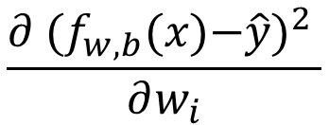

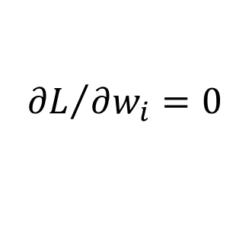
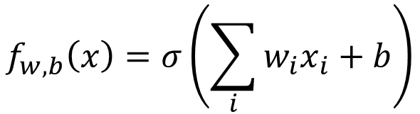
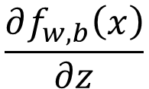
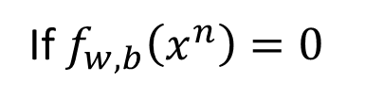

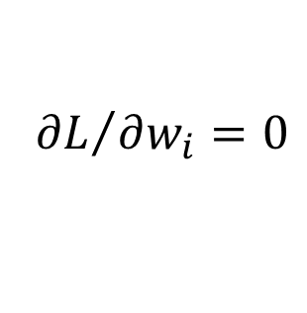
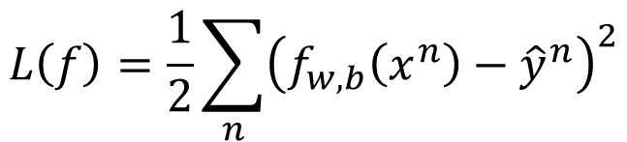
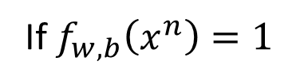

Logistic Regression + Square Error
$$f_{w,b}\left(x\right)=σ\left(\sum_{i}{w_{i}x_{i}}+b\right)$$
Step 1:
Step 2:
Training data: $\left(x^{n},{\hat{y}}^{n}\right)$, ${\hat{y}}^{n}$: 1 for class 1, 0 for class 2
$$L\left(f\right)=\frac{1}{2}\sum_{n}{{\left(f_{w,b}\left(x^{n}\right)−{\hat{y}}^{n}\right)}^{2}}$$
Step 3:
$$\frac{∂f_{w,b}\left(x\right)}{∂z}$$
$$\frac{∂z}{∂w_{i}}$$
$$=2\left(f_{w,b}\left(x\right)−\hat{y}\right)$$
$$\frac{∂ {(f_{w,b}\text{(}\text{x}\text{)−}\hat{y})}^{2} }{∂w_{i}}$$
$$=2\left(f_{w,b}\left(x\right)−\hat{y}\right)f_{w,b}\left(x\right)\left(1−f_{w,b}\left(x\right)\right)x_{i}$$
$${\hat{y}}^{n}=1$$
If $f_{w,b}\left(x^{n}\right)=1$
(close to target)
$${∂L}/{∂w_{i}}=0$$
If $f_{w,b}\left(x^{n}\right)=0$
(far from target)
$${∂L}/{∂w_{i}}=0$$

Slide 13

Logistic Regression + Square Error
$$f_{w,b}\left(x\right)=σ\left(\sum_{i}{w_{i}x_{i}}+b\right)$$
Step 1:
Step 2:
Training data: $\left(x^{n},{\hat{y}}^{n}\right)$, ${\hat{y}}^{n}$: 1 for class 1, 0 for class 2
$$L\left(f\right)=\frac{1}{2}\sum_{n}{{\left(f_{w,b}\left(x^{n}\right)−{\hat{y}}^{n}\right)}^{2}}$$
Step 3:
$$\frac{∂f_{w,b}\left(x\right)}{∂z}$$
$$\frac{∂z}{∂w_{i}}$$
$$=2\left(f_{w,b}\left(x\right)−\hat{y}\right)$$
$$\frac{∂ {(f_{w,b}\text{(}\text{x}\text{)−}\hat{y})}^{2} }{∂w_{i}}$$
$$=2\left(f_{w,b}\left(x\right)−\hat{y}\right)f_{w,b}\left(x\right)\left(1−f_{w,b}\left(x\right)\right)x_{i}$$
$${\hat{y}}^{n}=0$$
If $f_{w,b}\left(x^{n}\right)=1$
(far from target)
$${∂L}/{∂w_{i}}=0$$
If $f_{w,b}\left(x^{n}\right)=0$
(close to target)
$${∂L}/{∂w_{i}}=0$$

Slide 14
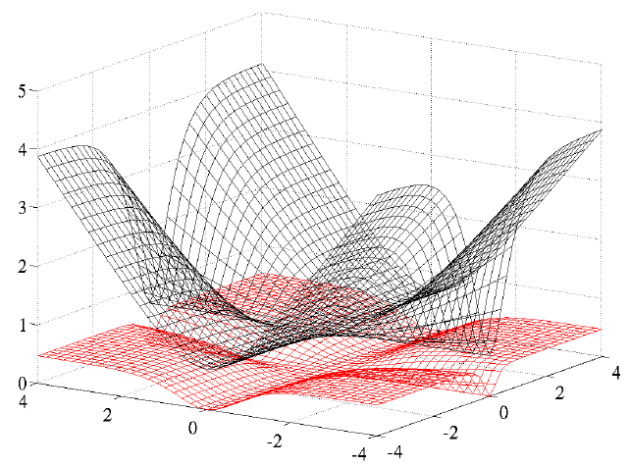
Cross Entropy v.s. Square Error
Cross Entropy
Total
Loss
Square
Error
w₁
w₂
http://jmlr.org/proceedings/papers/v9/glorot10a/glorot10a.pdf

Slide 15
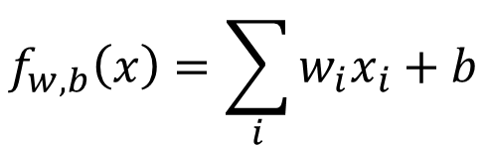
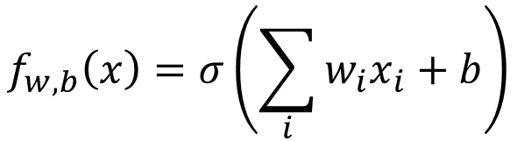
Logistic Regression
Linear Regression
$$f_{w,b}\left(x\right)=σ\left(\sum_{i}{w_{i}x_{i}}+b\right)$$
$$f_{w,b}\left(x\right)=\sum_{i}{w_{i}x_{i}}+b$$
Step 1:
Output: between 0 and 1
Output: any value
Step 2:
Step 3:
Notes:
The standard logistic function is the logistic function with parameters (k = 1, x₀ = 0, L = 1) which yields sigmoid

Slide 16
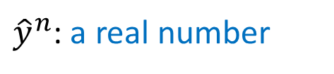
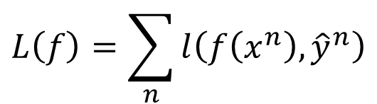
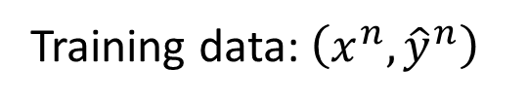
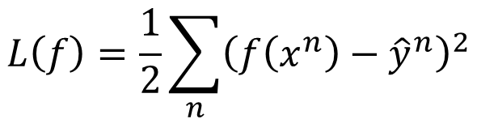
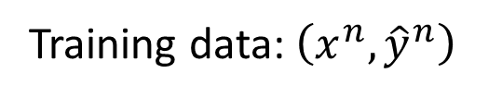

Logistic Regression
Linear Regression
$$f_{w,b}\left(x\right)=σ\left(\sum_{i}{w_{i}x_{i}}+b\right)$$
$$f_{w,b}\left(x\right)=\sum_{i}{w_{i}x_{i}}+b$$
Step 1:
Output: between 0 and 1
Output: any value
Training data: $\left(x^{n},{\hat{y}}^{n}\right)$
Training data: $\left(x^{n},{\hat{y}}^{n}\right)$
Step 2:
${\hat{y}}^{n}$: 1 for class 1, 0 for class 2
${\hat{y}}^{n}$: a real number
$$L\left(f\right)=\sum_{n}{l\left(f\left(x^{n}\right),{\hat{y}}^{n}\right)}$$
$$L\left(f\right)=\frac{1}{2}\sum_{n}{{\left(f\left(x^{n}\right)−{\hat{y}}^{n}\right)}^{2}}$$
Cross entropy:
$$l\left(f\left(x^{n}\right),{\hat{y}}^{n}\right)=−\left[{\hat{y}}^{n}lnf\left(x^{n}\right)+\left(1−{\hat{y}}^{n}\right)ln\left(1−f\left(x^{n}\right)\right)\right]$$
Notes:
The standard logistic function is the logistic function with parameters (k = 1, x₀ = 0, L = 1) which yields sigmoid

Slide 17
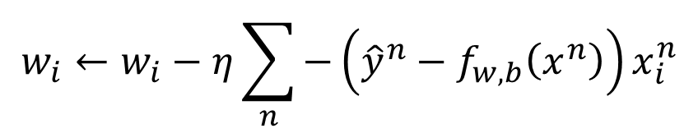
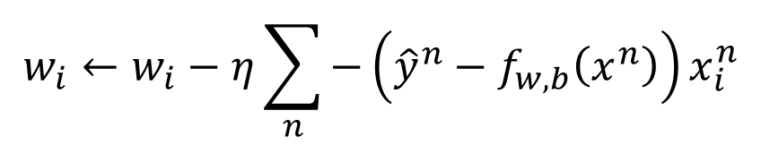
Logistic Regression
Linear Regression
$$f_{w,b}\left(x\right)=σ\left(\sum_{i}{w_{i}x_{i}}+b\right)$$
$$f_{w,b}\left(x\right)=\sum_{i}{w_{i}x_{i}}+b$$
Step 1:
Output: between 0 and 1
Output: any value
Training data: $\left(x^{n},{\hat{y}}^{n}\right)$
Training data: $\left(x^{n},{\hat{y}}^{n}\right)$
Step 2:
${\hat{y}}^{n}$: 1 for class 1, 0 for class 2
${\hat{y}}^{n}$: a real number
$$L\left(f\right)=\sum_{n}{l\left(f\left(x^{n}\right),{\hat{y}}^{n}\right)}$$
$$L\left(f\right)=\frac{1}{2}\sum_{n}{{\left(f\left(x^{n}\right)−{\hat{y}}^{n}\right)}^{2}}$$
$$w_{i}←w_{i}−η\sum_{n}{−\left({\hat{y}}^{n}−f_{w,b}\left(x^{n}\right)\right)x_{i}^{n}}$$
Logistic regression:
Step 3:
$$w_{i}←w_{i}−η\sum_{n}{−\left({\hat{y}}^{n}−f_{w,b}\left(x^{n}\right)\right)x_{i}^{n}}$$
Linear regression:
Notes:
The standard logistic function is the logistic function with parameters (k = 1, x₀ = 0, L = 1) which yields sigmoid

Slide 18


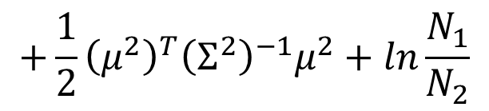
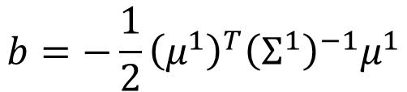

Discriminative v.s. Generative
$$P\left(C_{1}|x\right)=σ\left(w∙x+b\right)$$
directly find w and b
Find $μ^{1}$, $μ^{2}$, $Σ^{−1}$
$$w^{T}={\left(μ^{1}−μ^{2}\right)}^{T}Σ^{−1}$$
$$b=−\frac{1}{2}{\left(μ^{1}\right)}^{T}{\left(Σ^{1}\right)}^{−1}μ^{1}$$
Will we obtain the same set of w and b?
$$+\frac{1}{2}{\left(μ^{2}\right)}^{T}{\left(Σ^{2}\right)}^{−1}μ^{2}+ln\frac{N_{1}}{N_{2}}$$
The same model (function set), but different function may be selected by the same training data.

Slide 19


Generative v.s. Discriminative
Generative
Discriminative
All: hp, att, sp att, de, sp de, speed
73% accuracy
79% accuracy
Notes:
0.657142857143 0.485714285714

Slide 20

Generative v.s. Discriminative
Example
Training
Data
1
1
0
0
X 4
X 4
X 4
1
0
1
0
Class 1
Class 2
Class 2
Class 2
Testing
Data
1
How about Naïve Bayes?
Class 1?
Class 2?
1
$$P\left(x|C_{i}\right)=P\left(x_{1}|C_{i}\right)P\left(x_{2}|C_{i}\right)$$
Notes:
腦補的 model

Slide 21






Generative v.s. Discriminative
Example
Training
Data
1
1
0
0
X 4
X 4
X 4
1
0
1
0
Class 1
Class 2
Class 2
Class 2
$$P\left(C_{1}\right)=\frac{1}{13}$$
$$P\left(x_{1}=1|C_{1}\right)=1$$
$$P\left(x_{2}=1|C_{1}\right)=1$$
$$P\left(C_{2}\right)=\frac{12}{13}$$
$$P\left(x_{1}=1|C_{2}\right)=\frac{1}{3}$$
$$P\left(x_{2}=1|C_{2}\right)=\frac{1}{3}$$
Notes:
腦補的 model

Slide 22








Training
Data
1
1
0
0
X 4
X 4
X 4
1
0
1
0
Class 1
Class 2
Class 2
Class 2
$$\frac{1}{13}$$
$$1×1$$
<0.5
$$=\frac{P\left(x|C_{1}\right)P\left(C_{1}\right)}{P\left(x|C_{1}\right)P\left(C_{1}\right)+P\left(x|C_{2}\right)P\left(C_{2}\right)}$$
Testing
Data
1
$$P\left(C_{1}|x\right)$$
1
$$\frac{1}{13}$$
$$\frac{1}{3}×\frac{1}{3}$$
$$\frac{12}{13}$$
$$1×1$$
$$P\left(C_{1}\right)=\frac{1}{13}$$
$$P\left(x_{1}=1|C_{1}\right)=1$$
$$P\left(x_{2}=1|C_{1}\right)=1$$
$$P\left(C_{2}\right)=\frac{12}{13}$$
$$P\left(x_{1}=1|C_{2}\right)=\frac{1}{3}$$
$$P\left(x_{2}=1|C_{2}\right)=\frac{1}{3}$$
Notes:
腦補的 model

Slide 23
Generative v.s. Discriminative
Usually people believe discriminative model is better
Benefit of generative model
With the assumption of probability distribution
less training data is needed
more robust to the noise
Priors and class-dependent probabilities can be estimated from different sources.
Notes:
For separation, we can talk about ASR

Slide 24







Multi-class Classification
(3 classes as example)
C₁:
$$z_{1}=w^{1}∙x+b_{1}$$
Probability:
$1>y_{i}>0$
$\sum_{i}{y_{i}=1}$
$$w^{1},b_{1}$$
C₂:
$$w^{2},b_{2}$$
$$z_{2}=w^{2}∙x+b_{2}$$
C₃:
$$w^{3},b_{3}$$
$$z_{3}=w^{3}∙x+b_{3}$$
Softmax
3
20
0.88
1
2.7
0.12
-3
0.05
≈0
Notes:
2 class

Slide 25

















Multi-class Classification
[Bishop, P209-210]
(3 classes as example)
$$z_{1}=w^{1}∙x+b_{1}$$
Cross Entropy
$$x$$
$$z_{2}=w^{2}\text{∙}x+b_{2}$$
Softmax
$$−\sum_{i=1}^{3}{{\hat{y}}_{i}lny_{i}}$$
$$z_{3}=w^{3}\text{∙}x+b_{3}$$
target
If x $∈$ class 1
If x $∈$ class 2
If x $∈$ class 3
$$\left[\begin{aligned}1 \\ 0 \\ 0\end{aligned}\right]$$
$$\left[\begin{aligned}0 \\ 1 \\ 0\end{aligned}\right]$$
$$\left[\begin{aligned}0 \\ 0 \\ 1\end{aligned}\right]$$
$$\hat{y}=$$
$$\hat{y}=$$
$$\hat{y}=$$
$$−lny_{1}$$
$$−lny_{2}$$
$$−lny_{3}$$

Slide 26



Limitation of Logistic Regression
$$(z≥0)$$
$$(z<0)$$
Can we?
Input Feature |  | Label
x₁ | x₂
0 | 0 | Class 2
0 | 1 | Class 1
1 | 0 | Class 1
1 | 1 | Class 2
z ≥ 0
z < 0
z < 0
z ≥ 0
Notes:
The preceding example employed typical “opportunistic,” or found, data. But even data generated by a designed experiment need external information. A DoD project from the early days of neural networks attempted to distinguish aerial images of forests with and without tanks in them. Perfect performance was achieved on the training set, and then on an outof-sample set of data that had been gathered at the same time but not used for training. This was celebrated but, wisely, a confirming study was performed. New images were collected on which the models performed extremely poorly. This drove investigation into the features driving the models and revealed them to be magnitude readings from specific locations of the images; i.e., background pixels. It turns out that the day the tanks had been photographed was sunny, and that for nontanks, cloudy!11 Even resampling the original data wouldn’t have protected against this error, as the flaw was inherent in the generating experiment.
PBS featured this project in a 1991 documentary series The Machine That Changed the World: Episode IV, “The Thinking Machine.”

Slide 27












Limitation of Logistic Regression
$x_{1}^{′}$: distance to $\left[\begin{aligned}0 \\ 0\end{aligned}\right]$
$x_{2}^{′}$: distance to $\left[\begin{aligned}1 \\ 1\end{aligned}\right]$
Feature transformation
$$\left[\begin{aligned}x_{1} \\ x_{2}\end{aligned}\right]$$
$$\left[\begin{aligned}x_{1}^{′} \\ x_{2}^{′}\end{aligned}\right]$$
Not always easy ….. domain knowledge can be helpful
$$x_{2}^{′}$$
$$\left[\begin{aligned}0 \\ \sqrt{2}\end{aligned}\right]$$
$$\left[\begin{aligned}0 \\ 1\end{aligned}\right]$$
$$\left[\begin{aligned}1 \\ 1\end{aligned}\right]$$
$$\left[\begin{aligned}0 \\ 0\end{aligned}\right]$$
$$\left[\begin{aligned}0 \\ 1\end{aligned}\right]$$
$$\left[\begin{aligned}1 \\ 1\end{aligned}\right]$$
$$\left[\begin{aligned}\sqrt{2} \\ 0\end{aligned}\right]$$
$$x_{1}^{′}$$

Slide 28


Limitation of Logistic Regression
Cascading logistic regression models
$$x_{1}^{′}$$
$$x_{2}^{′}$$
Feature Transformation
Classification
(ignore bias in this figure)

Slide 29













$x_{1}^{′}$=0.73
$x_{1}^{′}$=0.27
-1
-2
$$x_{1}^{′}$$
$x_{1}^{′}$=0.27
$x_{1}^{′}$=0.05
2
2
$x_{2}^{′}$=0.05
$x_{2}^{′}$=0.27
-2
$$x_{2}^{′}$$
-1
$x_{2}^{′}$=0.27
$x_{2}^{′}$=0.73
Notes:
1,-1,-3

Slide 30













$x_{1}^{′}$=0.73
$x_{1}^{′}$=0.27
$$x_{1}^{′}$$
$x_{1}^{′}$=0.27
$x_{1}^{′}$=0.05
$$x_{2}^{′}$$
$x_{2}^{′}$=0.05
$x_{2}^{′}$=0.27
(0.73, 0.05)
$$x_{2}^{′}$$
(0.27, 0.27)
(0.05,0.73)
$x_{2}^{′}$=0.27
$x_{2}^{′}$=0.73
$$x_{1}^{′}$$

Slide 31


Deep Learning!
All the parameters of the logistic regressions are jointly learned.
“Neuron”
$$x_{1}^{′}$$
$$x_{2}^{′}$$
Feature Transformation
Classification
Neural Network

Slide 32
Reference
Bishop: Chapter 4.3

Slide 33
Acknowledgement
感謝 林恩妤 發現投影片上的錯誤

Slide 34
Appendix
Notes:
Good ref:
http://www.win-vector.com/blog/2011/09/the-simpler-derivation-of-logistic-regression/
http://www.cs.columbia.edu/~smaskey/CS6998/slides/statnlp_week6.pdf
http://www.win-vector.com/dfiles/LogisticRegressionMaxEnt.pdf
New ton:
http://qwone.com/~jason/writing/lr.pdf
Gradient descent/Another point of view
Why not MSE
Multiple Limit
Ds v.s. generative X 2

Slide 35

















Three Steps
$$x^{1}$$
$$x^{2}$$
$$x^{3}$$
$$x^{n}$$
$$……$$
$${\hat{y}}^{1}$$
$${\hat{y}}^{2}$$
$${\hat{y}}^{3}$$
$${\hat{y}}^{n}$$
$${\hat{y}}^{n}=class 1,class 2$$
Step 1. Function Set (Model)
Step 2. Goodness of a function
Step 3. Find the best function: gradient descent
$$x$$
If $P\left(C_{1}|x\right)>0.5$, output: y = class 1
$$y$$
feature
Otherwise, output: y = class 2
class
$$P\left(C_{1}|x\right)=σ\left(w∙x+b\right)$$
w and b are related to$N_{1},$ $N_{2}$, $μ^{1}$, $μ^{2}$, $Σ$
$$L\left(f\right)=\sum_{n}{δ\left(f\left(x^{n}\right)≠{\hat{y}}^{n}\right)}$$
$$L\left(f\right)=\sum_{n}{l\left(f\left(x^{n}\right)≠{\hat{y}}^{n}\right)}$$
Notes:
The number of times g get incorrect results on training data.

Slide 36









Step 2: Loss function
z
$$≥$$
0
class 1
+1
$$f_{w,b}\left(x\right)=$$
z
$$<$$
0
class 2
-1
Ideal loss:
Approximation:
$$L\left(f\right)=\sum_{n}{δ\left(f\left(x^{n}\right)≠{\hat{y}}^{n}\right)}$$
$$L\left(f\right)=\sum_{n}{l\left(f\left(x^{n}\right),{\hat{y}}^{n}\right)}$$
0 or 1
$l\left(∗\right)$ is the upper bound of $δ\left(∗\right)$
Ideal loss
$$δ\left(f\left(x^{n}\right)≠{\hat{y}}^{n}\right)$$
$${\hat{y}}^{n}z^{n}$$
Notes:
我會說這個圖是 "plot of loss functions"﻿

Slide 37


















Step 2: Loss function
$l\left(f\left(x^{n}\right),{\hat{y}}^{n}\right)$: cross entropy
$${\hat{y}}^{n}=+1$$
$$f\left(x^{n}\right)$$
Ground
Truth
cross entropy
1.0
$${\hat{y}}^{n}=−1$$
$$1−f\left(x^{n}\right)$$
If ${\hat{y}}^{n}=+1$:
$$=−ln\frac{1}{1+exp\left(−z^{n}\right)}$$
$$l\left(f\left(x^{n}\right),{\hat{y}}^{n}\right)=−lnf\left(x^{n}\right)$$
$$=−lnσ\left(z^{n}\right)$$
$$=ln\left(1+exp\left(−z^{n}\right)\right)$$
$$=ln\left(1+exp\left(−{{\hat{y}}^{n}z}^{n}\right)\right)$$
If ${\hat{y}}^{n}=−1$:
$$l\left(f\left(x^{n}\right),{\hat{y}}^{n}\right)=−ln\left(1−f\left(x^{n}\right)\right)$$
$$=−ln\frac{exp\left(−z^{n}\right)}{1+exp\left(−z^{n}\right)}$$
$$=−ln\frac{1}{1+exp\left(z^{n}\right)}$$
$$=−ln\left(1−σ\left(x^{n}\right)\right)$$
$$=ln\left(1+exp\left(z^{n}\right)\right)$$
$$=ln\left(1+exp\left(−{{\hat{y}}^{n}z}^{n}\right)\right)$$

Slide 38





Step 2: Loss function
$l\left(f\left(x^{n}\right),{\hat{y}}^{n}\right)$: cross entropy
$$l\left(f\left(x^{n}\right),{\hat{y}}^{n}\right)=ln\left(1+exp\left(−{{\hat{y}}^{n}z}^{n}\right)\right)$$
Ideal loss
$$δ\left(f\left(x^{n}\right)≠{\hat{y}}^{n}\right)$$
Divided by ln2 here
$${\hat{y}}^{n}z^{n}$$

